Slide 1
Software Engineering and Architecture
The Framework Week

Slide 2
So Far…
Up until now we have discussed
A lot of Patterns which underlying flexible architectures
Supporting variations of software along one axis/dimension
Strategy: Vary between algorithms to fulfill responsibility
Etc.
The Theme of this week is
Frameworks: Combining Patterns to have flexible systems
Supporting variations in a (large) set of dimensions
A great showcase of the power of patterns…

Slide 3
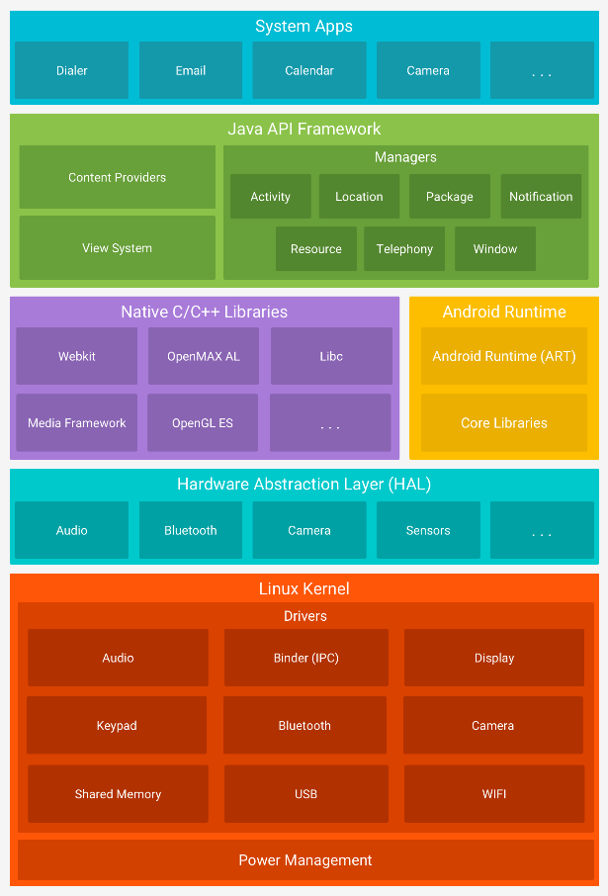
Programming Smartphones
One child, many names…
Platform, stack
Framework

Slide 4
Another one
And already building one ☺ - HotStone…

Slide 5
This Week
Start by a (smaller than Android) example
MiniDraw
Provide hints for Iteration 8 mandatory
To get you going…
Define Frameworks from a theoretical perspective
Terminology, structure, benefits and liabilities
Examplify
MiniDraw, Your HotStone, Android, Java Swing, …
… as Screencast…

